Slide 1
PROJECT REPORT MEDIA STADIUM MULTIMEDIA COMPETITION SITE Jack Powers Interactive Technology & Pedagogy Program May 2011

Slide 2
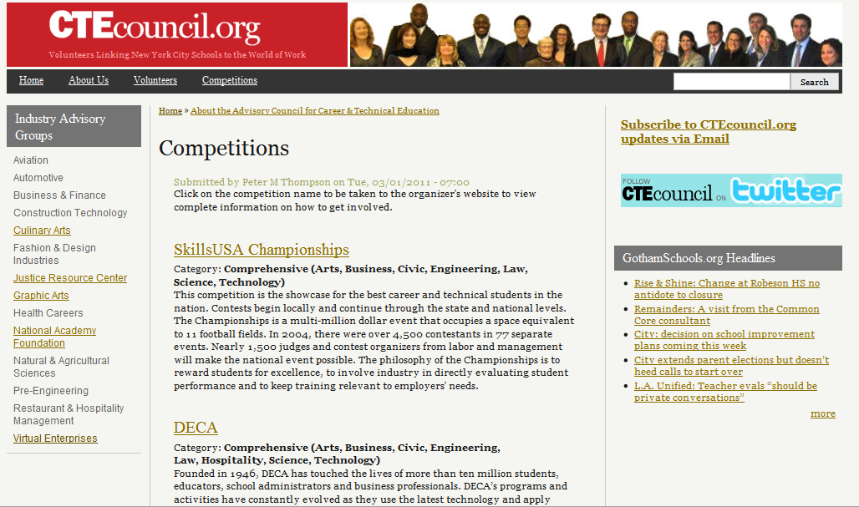
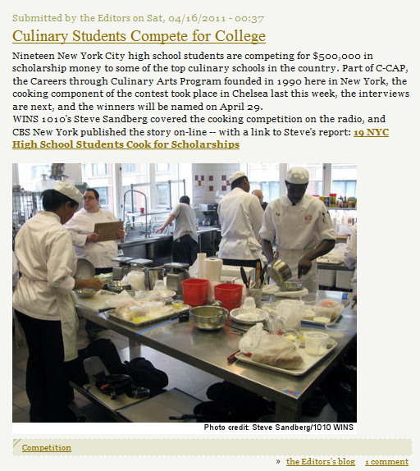
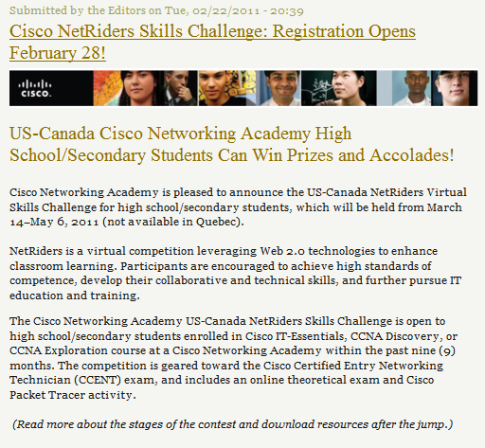

Slide 3
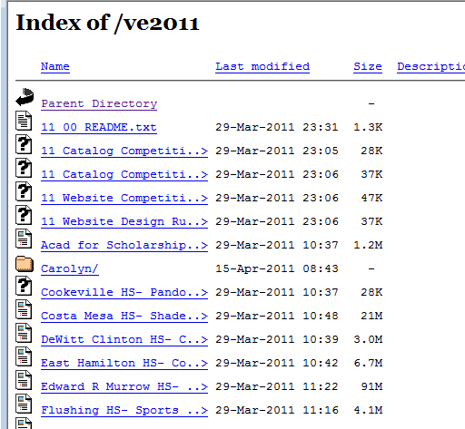
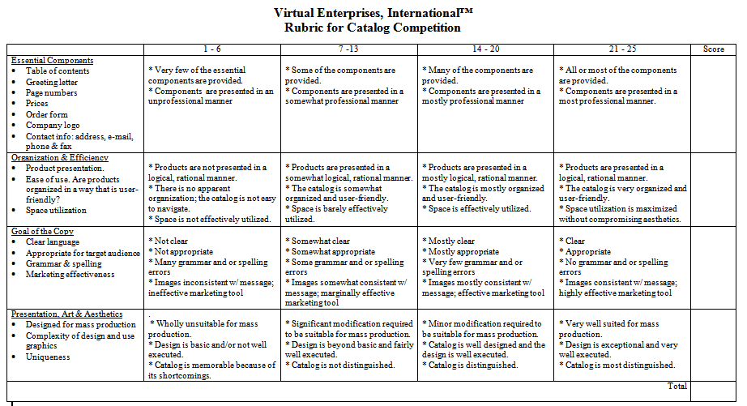
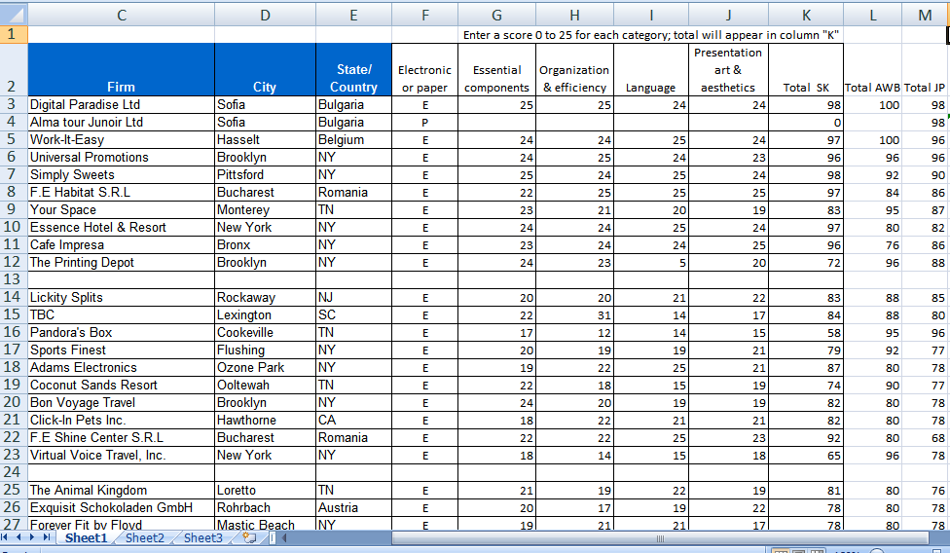

Slide 4
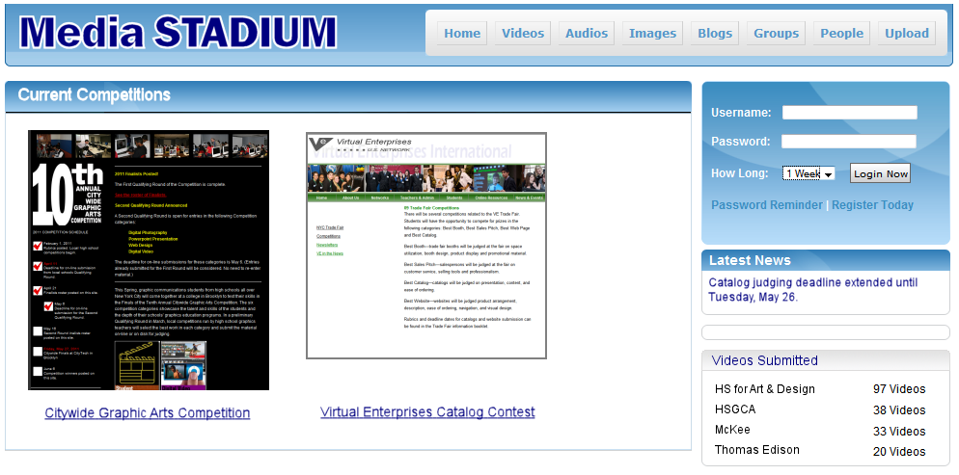

Slide 5
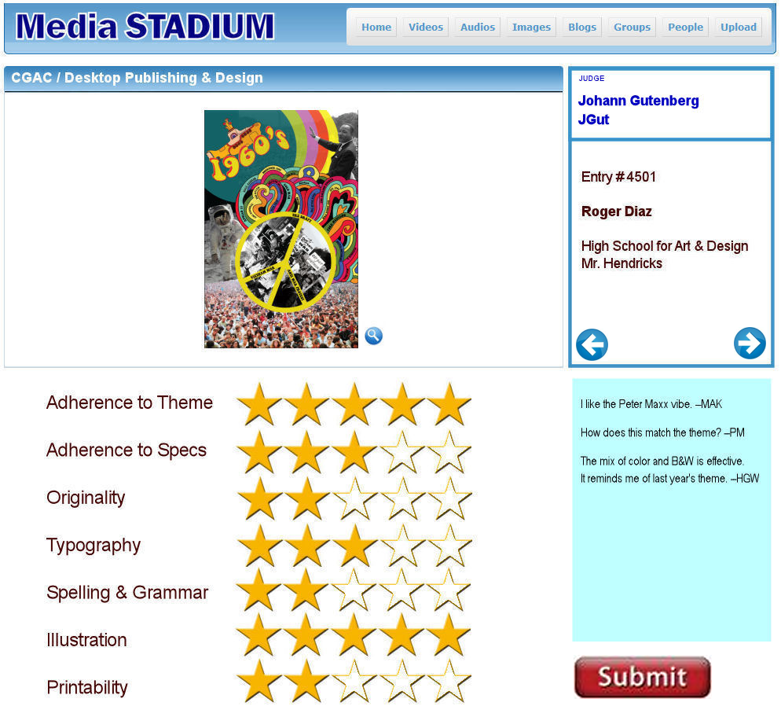

Slide 6
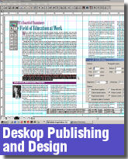
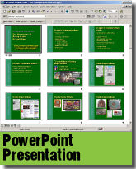
FILE FORMATS
PDF
JPG
PPT
HTML Site
MOV, MPEG2, MPEG4, FLV

Slide 7
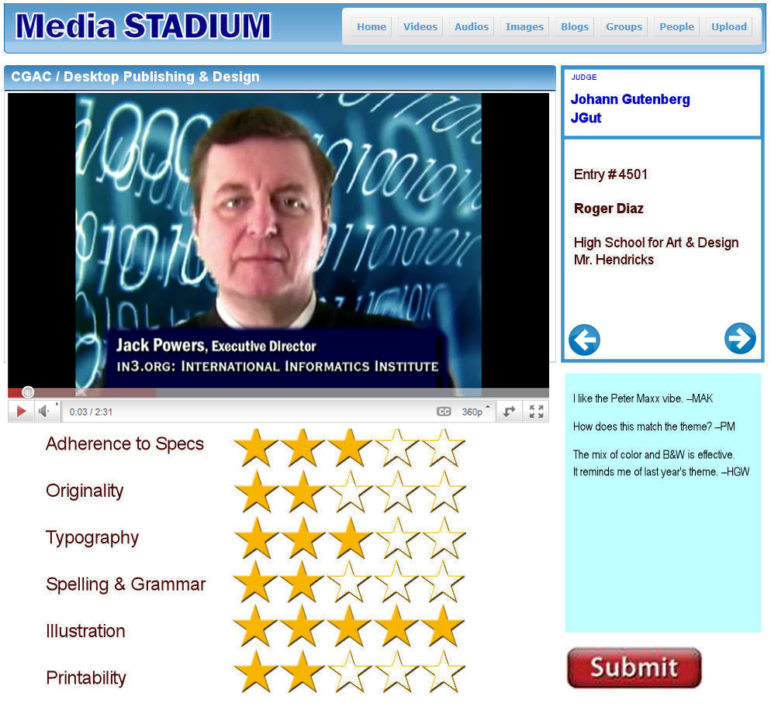

Slide 8
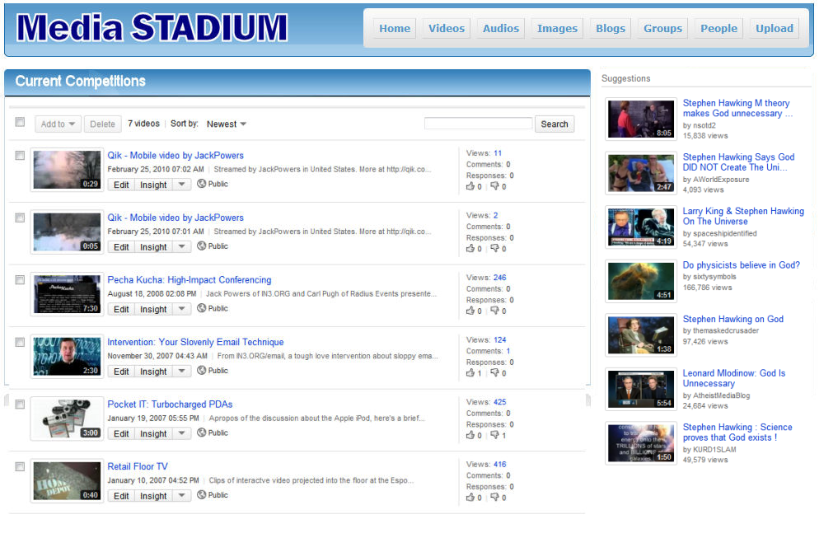

Slide 9
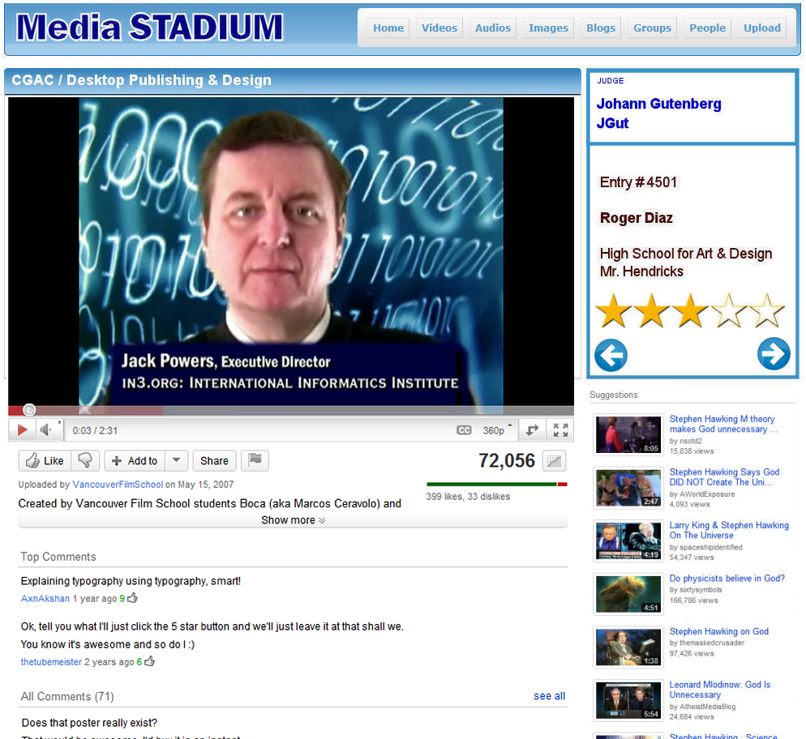

Slide 10
Targets
Media Arts Teachers
Participate in a community of practice on-line
Develop critical self-reflection
Share teaching tips and tricks
Industry Advisors
Review curricula and outcomes
Show off student work to partners and sponsors
Students
Share best practices and winning strategies
Showcase portfolio work

Slide 11
PROJECT REPORT MEDIA STADIUM MULTIMEDIA COMPETITION SITE Jack Powers Interactive Technology & Pedagogy Program May 2011

