Slide 1
EVALUATING
FOR-PROFIT
ONLINE LEARNING
PROGRAMS
Jack Powers
Education Networks: Power, Wealth, Cyberspace and the
Digital Mind / Profs Picciano and Spring / Nov 2011

Slide 2
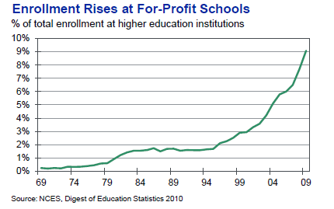





FOR-PROFIT / PRIVATE SECTOR
ONLINE LEARNING PROVIDERS

Slide 3

MEASURING INPUTS
Campus
Student Life
Faculty
Program
Costs

Slide 4
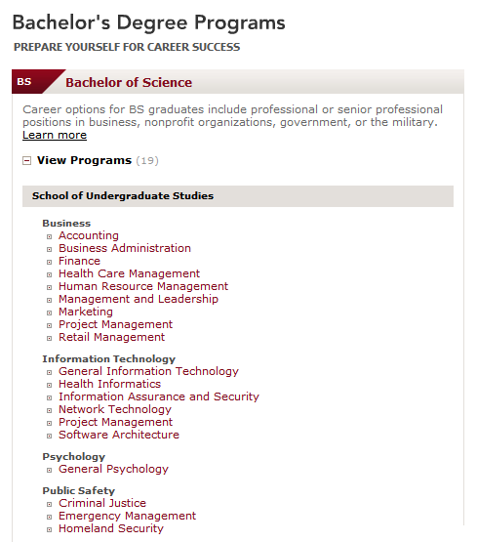
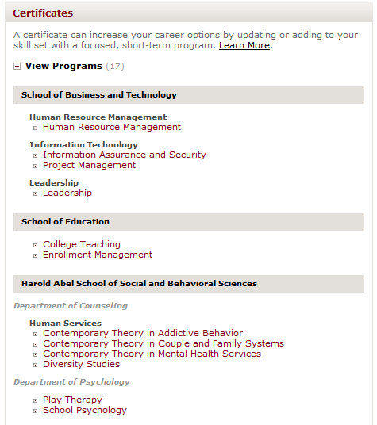
BUSINESS & TECHNICAL PROGRAMS

Slide 5
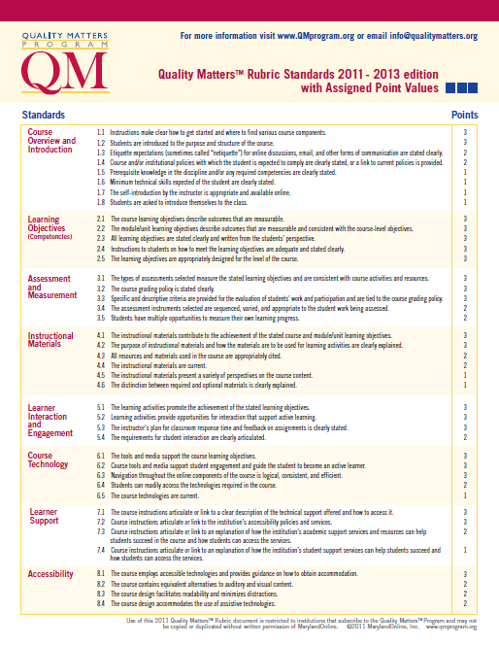

ONLINE LEARNING QUALITY

Slide 6
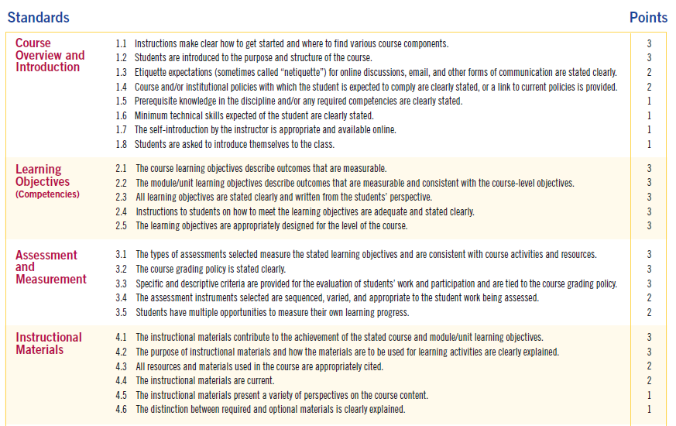
QUALITY MATTERS

Slide 7
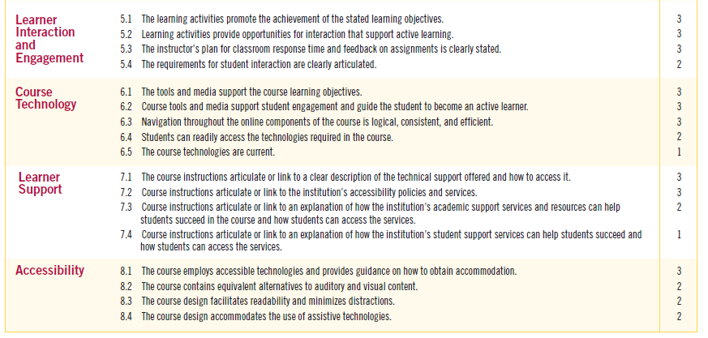
QUALITY MATTERS

Slide 8

MEASURING OUTCOMES
Retention
Graduation
Placement
Salary

Slide 9
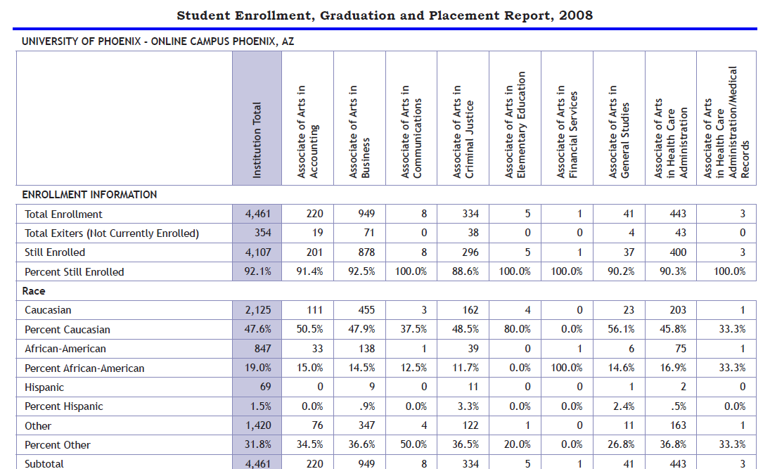
TENNESSEE REPORTS
Tennessee Higher Education Commission

Slide 10
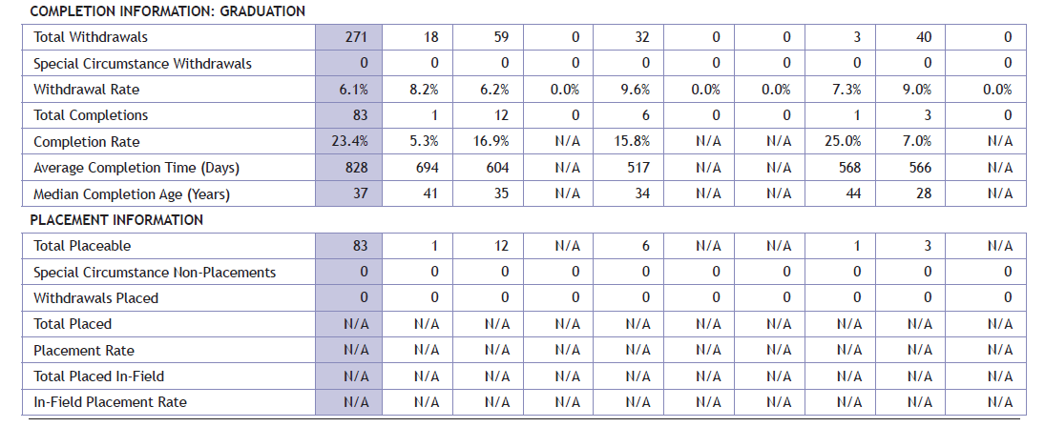

Slide 11
OUTCOMES ANALYSIS
University of Phoenix On-Line
CollegeResults.org
Six Year Graduation Rate 4.2%
2009 RESULTS PHOENIX TENN
Associate of Arts in Business 47% 75.1%
Bachelor’s of Science in
Business/Management 70% 85.2

Slide 12
OUTCOMES ANALYSIS
Tennessee Employment Stats
University of Phoenix On-Line
2009 EMPLOYMENT RESULTS PLACEABLE PLACED
Associate of Arts in Business 145 < 10
Bachelor’s of Science in
Business/Management 46 < 10

Slide 13
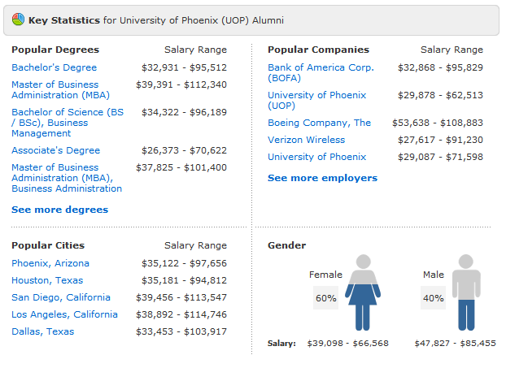
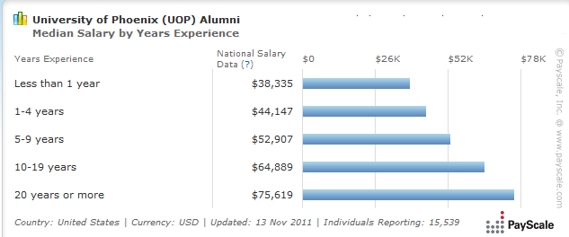
OUTCOMES ANALYSIS
Payscale.com
UOP’s Cost of B.S.
$33,800 to $74,500
Mean Debt
$30,799

Slide 14
ONLINE LEARNING EVOLUTION
Consistent
Transparent
Aligned
Interoperable
Compliant
Marketed

Slide 15
EVALUATING
FOR-PROFIT
ONLINE LEARNING
PROGRAMS
Jack Powers
Education Networks: Power, Wealth, Cyberspace and the
Digital Mind / Profs Picciano and Spring / Nov 2011
JPowers @ IN3.ORG / 646-207-1967

